Slide 1


Robust Object Detection in Complex Scenes
Guide
Presented by
Dr. Lekshmi K
Professor - Higher Academic Grade
SCOPE
Vellore Institute of Technology, Chennai
Vinayak Kumar Singh
23MCA1030

Slide 2

ABSTRACT
PROBLEM STATEMENT
Contents
LITERATURE REVIEW
OBJECTIVES
PROPOSED SOLUTION
MODULES IDENTIFIED
.

Slide 3
ABSTRACT
Object detection and recognition in cluttered environments, varying lighting conditions, and partial occlusion pose significant challenges in computer vision.
Accurately identifying and distinguishing objects becomes difficult when they are partially hidden, overlapped, or affected by inconsistent lighting.
Effective detection and recognition in such scenarios are essential for applications like autonomous driving, surveillance systems, and warehouse automation.
This research area aims to develop methods that reliably detect and recognize objects despite these obstacles, improving the accuracy and robustness of real-world systems.

Slide 4
PROBLEM STATEMENT
Accurately detecting and recognizing objects in real-world applications is crucial for autonomous driving, surveillance systems, and warehouse automation.
Traditional computer vision systems struggle in cluttered backgrounds, varying lighting conditions, and partial occlusion, leading to decreased accuracy and reliability.
There is a need for advanced object detection techniques that can overcome these challenging conditions and maintain high performance.
This research aims to develop and propose solutions that enhance object recognition in complex and unpredictable environments.

Slide 5
OBJECTIVES
The objective is to develop and improve object detection techniques that can accurately identify and recognize objects in complex environments, even when there are challenges like cluttered backgrounds, changing lighting, and partially hidden objects.
The goal is to create more reliable and robust systems that can work effectively in real-world situations, such as in autonomous vehicles, security systems, and automated warehouses.

Slide 6
LITERATURE REVIEW
S.No | TITLE(YEAR) | TECHNOLOGY USED | PROBLEM SOLVED | OBSERVATIONS
1 | A comprehensive approach to remote sensing object detection and scene understanding (2024) | R-CNN (Region-based Convolutional Neural Network) DOTA and DIOR Datasets | Solve problem of detecting small and densely packed objects in remote sensing images by improving feature extraction and reducing information loss using advanced neural network techniques. | The proposed multiscale-attention R-CNN (MSA R-CNN) significantly outperforms existing models in object detection and background information extraction in remote sensing images.
2 | A Robust Cross-Weighted Thresholding Method for Object Extraction in Complex Scenes (2024) | Adaptive thresholding Peak-weaken Otsu method (PWOTSU). | The paper presents the PWOTSU method to enhance image segmentation accuracy in complex scenes by improving threshold selection in challenges like noise and low contrast. | The proposed PWOTSU method consistently outperforms traditional thresholding techniques in accurately extracting objects from images with complex scenes, demonstrating superior robustness and efficiency.

Slide 7
S.No | TITLE(YEAR) | TECHNOLOGY USED | PROBLEM SOLVED | OBSERVATIONS
3 | An improved anchor‑free object detection method applied in complex scenes based on SDA‑DLA34 (2023) | SDA-DLA34 Soft Pooling | The paper solves the problem of finding objects that are hard to see because they are blurry or have changed shape in complicated backgrounds. | The SDA-DLA34 method improve by 5% compared to DLA34, enhancing small object detection without sacrificing processing speed.
4 | An Improved YOLO Model by Incorporating Attention Mechanism for Object Detection in Traffic Scene | YOLO-VSF model VGG16 backbone VanJee dataset | The paper addresses the sample imbalance problem in object detection and enhances feature extraction for improved accuracy in traffic scenes. | YOLO-VSF improves by 3.04% over YOLOv4, reaching 92.21% on the VanJee dataset, with fewer parameters than YOLOv7, enhancing accuracy and efficiency.
5 | Ensemble For Object Detection In Complex Traffic Scenes | Ensemble learning (bagging) R-CNN (Region-based Convolutional Neural Network) architecture | It improves detection accuracy and robustness in challenging traffic conditions. | Bagging R-CNN achieves superior detection accuracy over state-of-the-art methods on traffic and general object detection datasets.

Slide 8
S.No | TITLE(YEAR) | TECHNOLOGY USED | PROBLEM SOLVED | OBSERVATIONS
6 | Background subtraction via regional multi-feature-frequency model in complex scenes | Regional multi-feature-frequency model Adaptive thresholds for background subtraction. | Detecting multi-scale moving objects under dynamic backgrounds in complex scenes | Achieved highest overall F-Measure of 0.6114, outperforming 12 state-of-the-art algorithms on CDnet 2014 dataset.
7 | Robust Region Feature Synthesizer for Zero-Shot Object Detection | Generative adversarial networks (GANs) object detection networks (Faster R-CNN) | Zero-shot object detection - detecting objects from unseen classes without training examples | Achieved state-of-the-art performance, improving mAP by 0.8-3.3% on various datasets compared to previous methods.
8 | Noise-Robust Branch Feature Measure for Infrared Small Target Detection in Complex Scenes | 8-branch model Branch local contrast (BLC) | Improved robustness of infrared small target detection in complex scenes with background clutter. | The proposed BFM method achieved AUC > 0.95, SCRG > 699.64, and BSF > 49.17 on four real image sequences, outperforming comparison methods.

Slide 9
S.No | TITLE(YEAR) | TECHNOLOGY USED | PROBLEM SOLVED | OBSERVATIONS
9 | Multi-sensor fusion for robust localization with moving object segmentation in complex dynamic 3D scenes | LiDAR Deep learning | Robust localization and mapping in complex dynamic 3D environments | Achieved state-of-the-art 74.9% mIoU for moving object segmentation and reduced localization error by 30.6% on Livox dataset.
10 | Yolov4-based hybrid feature enhancement network with robust object detection under adverse weather conditions | YOLOv4 algorithm, camera-radar fusion | Robust object detection under adverse weather conditions for autonomous driving | The system improved moving object detection accuracy to 74.9% and reduced positioning errors by about 31% in tests.

Slide 10
PROPOSED SOLUTION
Implement the YOLO (You Only Look Once) algorithm to detect objects in real-time, leveraging its speed and accuracy for handling complex scenes.
Use the KITTI dataset, which contains real-world images with challenging conditions like varying lighting and cluttered backgrounds, to train and test the YOLO model.
Fine-tune the YOLO model to improve its performance in detecting partially occluded and overlapping objects, ensuring reliability in diverse scenarios.
Test the developed system in practical applications like autonomous driving or surveillance to validate its effectiveness in complex environments.

Slide 11
MODULE IDENTIFIED
Input Module: Handling real-world images from the KITTI Dataset.
Preprocessing Module: Data augmentation, normalization, and resizing of images.
Model Module (YOLO): The YOLO model for object detection.
Training Module: Training the YOLO model using the KITTI Dataset.
Detection Module: Detecting objects in complex scenes using the trained model.
Output Module: Generating detected objects with bounding boxes and labels.

Slide 12
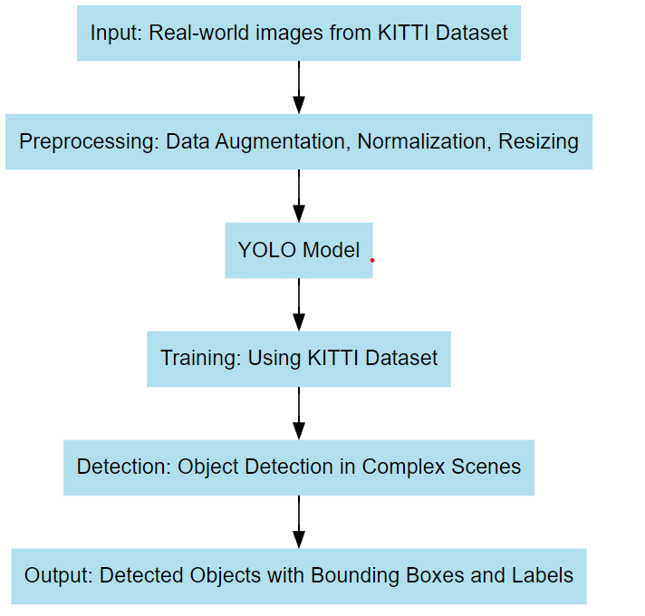
ARCHITECTURE

Slide 13
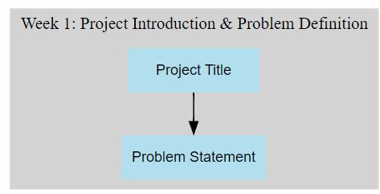
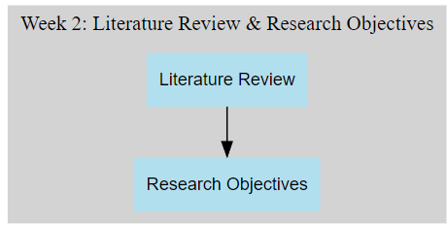
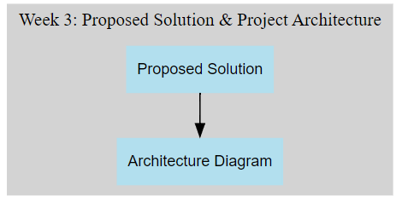
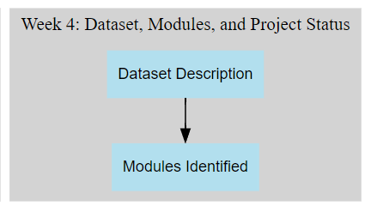
WORK PLAN TIMELINE

Slide 14


